Slide 1
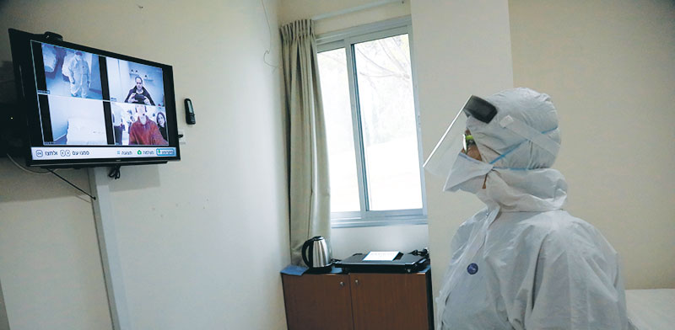
Programming for Everyone –
Final Project
Students: Adi Goldraich, ID 201038395
Yuval Nir, ID 307959965
Advisor: Dr. Michal Gordon
System’s name:
Medical helper at Corona times

Slide 2
Project Description
The system we created, is inspired by the complicated time we’re experiencing, it will be used to help Corona’s hospitalized people communicating with their doctors and support teams.
The system will be used at isolated rooms in hospitals\ Corona hotels to avoid contagion, and will help its users to communicate with the outer world.

Slide 3
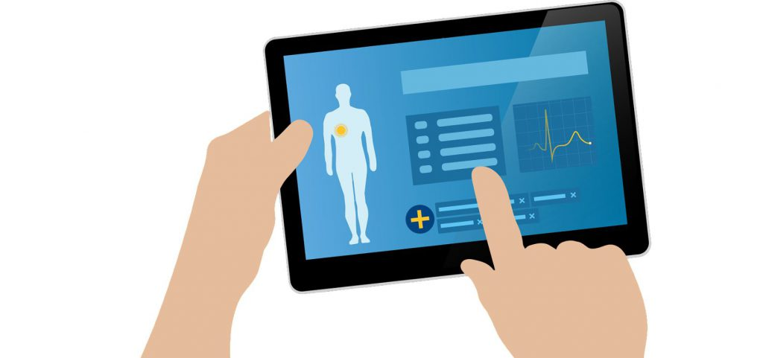
Inputs and Outputs
The system’s inputs are the pressings of the user on the system’s buttons which create system reactions. The system acts according to the user’s choices and provides him what he\she needs. Another kind of the system’s inputs are the variants which represent the users vital signs.
Therefor, the system’s outputs are the services the user gets to provide him\her the support – the general support, the doctor support and
the distress area which provides life-saving services.

Slide 4
Reactive Examples in the System
The system is directed by the user to it’s different states, according to the user’s answers\ button pressing.
For example, in the beginning the user needs to choose which part of the system he\she would like to use. Afterwards, if the user chose “Doctor support” for example, the system would act according to his medical tests and preferences. The system has a lot of different states that are affected by the variety of user’s decisions.
System Demonstration

Slide 5
System Demonstration
System Off
Press the power button to start
back

Slide 6
System Demonstration
Welcome to your Medical Helper!
Press the power button to turn the system off.
Press the distress button for emergency.
Help
Doctor Support
Distress!
Privacy Mode
back

Slide 7
System Demonstration
Help Services
Press the power button to turn the system off.
Press the distress button for emergency.
Press the return button to return to the main screen.
General Help
Mental Help
Distress!
Return
Privacy Mode
back

Slide 8
System Demonstration
Distress Situation
Press the power button to turn the system off.
Team is on his way!
Nurse approvement
back

Slide 9
System Demonstration
Preparing to meet the Doctor
Press the power button to turn the system off.
Press the distress button for emergency.
Press the return button to return to the main screen.
Start!
Distress!
Return
back

Slide 10
System Demonstration
Body Heat Test
Press the power button to turn the system off.
Press the distress button for emergency.
Press the return button to return to the main screen.
Take!
Distress!
Return
back

Slide 11
System Demonstration
Body Heat Test
Press the power button to turn the system off.
Press the distress button for emergency.
Press the return button to return to the main screen.
Measuring heat, please wait
Distress!
Return
back

Slide 12
System Demonstration
Pulse Rate and Blood Pressure test
Press the power button to turn the system off.
Press the distress button for emergency.
Press the return button to return to the main screen.
Take!
Distress!
Return
back

Slide 13
System Demonstration
Pulse Rate and Blood Pressure test
Press the power button to turn the system off.
Press the distress button for emergency.
Press the return button to return to the main screen.
Measuring pulse rate and blood pressure,
please wait
Distress!
Return
back

Slide 14
System Demonstration
Respiration Test
Press the power button to turn the system off.
Press the distress button for emergency.
Press the return button to return to the main screen.
Take!
Distress!
Return
back

Slide 15
System Demonstration
Respiration Test
Press the power button to turn the system off.
Press the distress button for emergency.
Press the return button to return to the main screen.
Measuring respiration, please wait
Distress!
Return
back

Slide 16
System Demonstration
Doctor Conversation
Press the power button to turn the system off.
Press the distress button for emergency.
Press the return button to return to the main screen.
Measuring respiration, please wait
Distress!
Return
back

Slide 17

System Demonstration
Doctor Conversation
Press the power button to turn the system off.
Press the distress button for emergency.
Distress!
Return
End Call
back

Slide 18
Statecharts

Slide 19
States and Transitions
The system consists of several parts like display, camera, microphone, indicators and others, which act in parallel and shows the orthogonality of the system.
Each of these parts contains states that illustrates the system’s reactions, starting from on\off and drilling down to any button pressed by the user and how it affects the other system parts.
The main part of the system is the Display which leads most of the system’s performances, and it’s transitions create the effects on the other states.

Slide 20
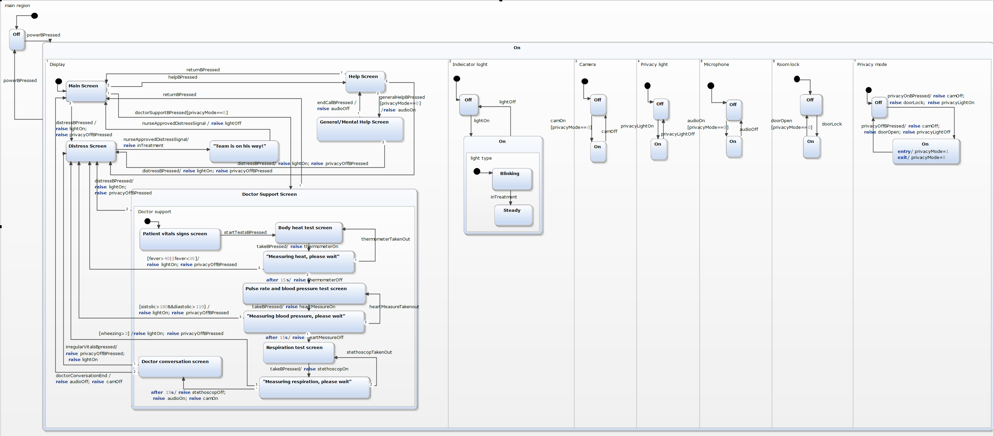
Statecharts from YAKINDU

Slide 21
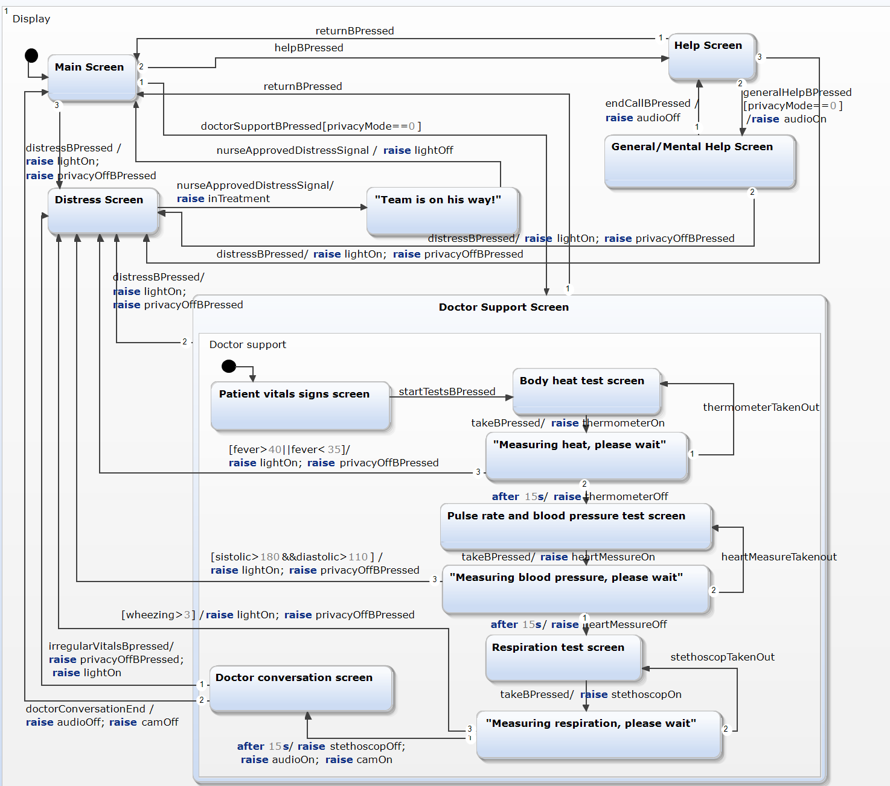
Statecharts from YAKINDU
The display part consists of 3 different services that the system offers – the general/ mental help area, the distress area and the doctor support area. Each contains a lot of transitions that depend on the user’s choices and vital signs.

Slide 22
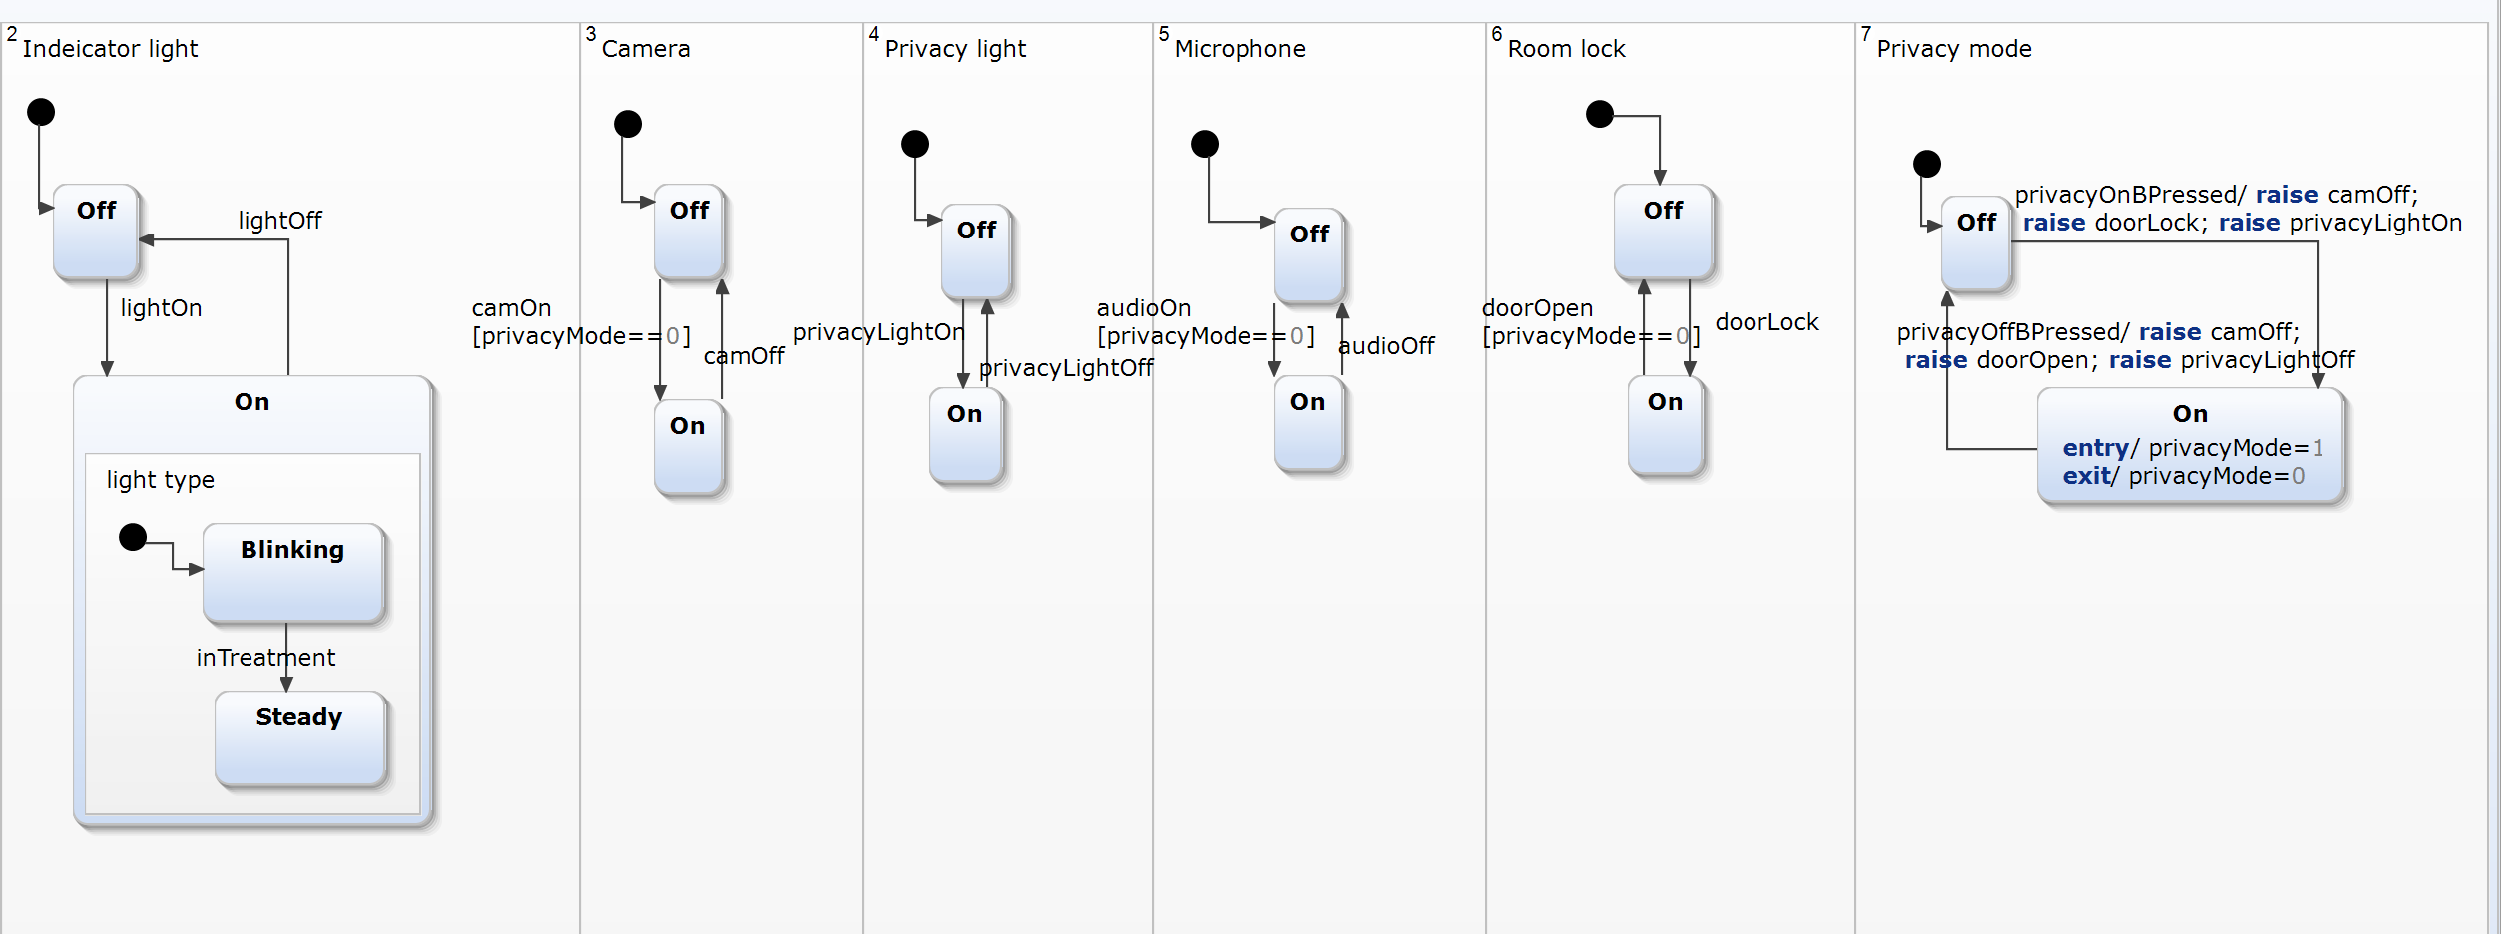
Statecharts from YAKINDU
The other components of the system – the lights, microphone, camera, locks and privacy mode, are mostly triggered to act according to the display part. A lot of transitions in the display section have effects that create these components reactions.

Slide 23
LSC

Slide 24
LSC – Primary demands:
When the system is Off and the user presses the power button, the system turns On and shows the main screen. Then, when the user presses the power button, the system turns Off.
When the user presses the Help button in the main screen, the screen changes to General Help screen. Then ,when the user presses the Return button, the screen changes back to the main screen.
When the user presses the End Call button in General/ Mental Help screen, the screen changes back to Help screen and the audio turns Off.
When the user presses the Distress button the screen changes to Distress screen, the indicator light turns on and the privacy mode goes off.
When the nurse presses the Approve distress signal button in her control system, the indicator light changes from blinking to steady.
When the privacy mode is off and the user presses the Doctor Support button, the screen changes to Doctor Support screen.
When the screen is Doctor Support screen and the user presses the Return button, the screen changes to main screen.
When the screen is in Body heat test screen and the user presses the “Take” button, the thermometer turns on and the screen changes to “Measuring heat, please wait”. Then, after 15 seconds the thermometer turns off and the screen changes to “Pulse rate and blood pressure test screen”.

Slide 25
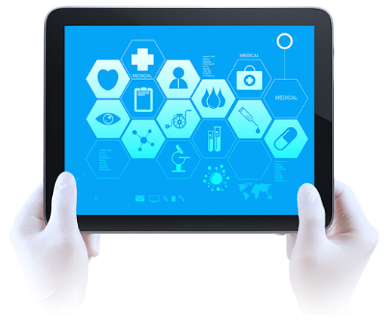
LSC – Primary demands:
When the screen is in Pulse rate and blood pressure test screen and the user presses the “Take” button, the heart measurer turns on and the screen changes to “Measuring blood pressure, please wait”. Then, after 15 seconds the heart measurer turns off and the screen changes to “Respiration test screen”.
When the screen is in Respiration test screen and the user presses the “Take” button, the stethoscope turns on and the screen changes to “Measuring Respiration please wait”. Then, after 15 seconds the stethoscope turns off and the screen changes to Doctor conversation screen.
When the screen is in Doctor conversation screen and the doctor presses the Irregular Vitals button, the screen changes to Distress screen, the indicator light turns on and the privacy mode turns off.
When the screen is in Doctor conversation screen and the doctor presses the Conversation End button, the screen goes back to main screen, the microphone turns off and the camera turns off.
When the privacy mode is off and the PrivacyOn button is pressed, the camera
turns off, the room lock turns on and the privacy light turns on.

Slide 26
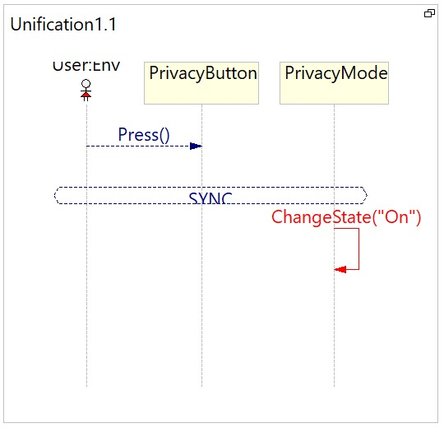
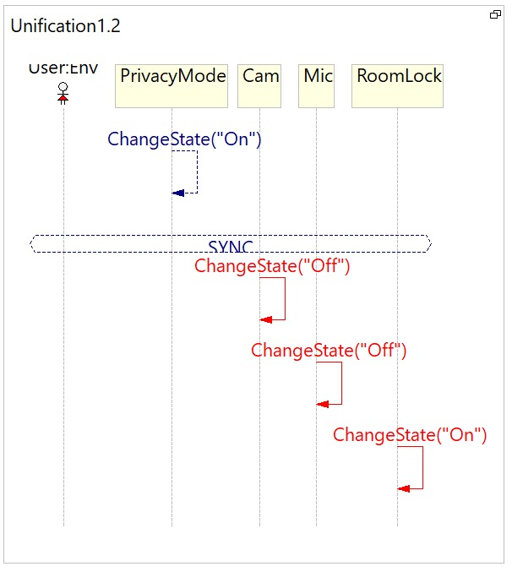
LSC Unification 1 – When the user presses the Privacy button, the Privacy mode turns on.
When the Privacy mode turns on, the Camera and Microphone turn off and the Roomlock turns on.

Slide 27
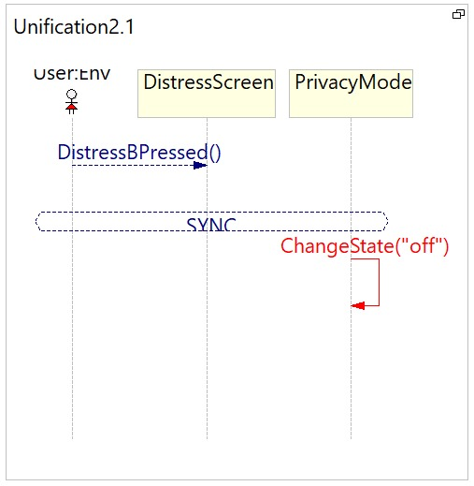

LSC Unification 2 – When the user presses the Distress Button, the PrivacyMode changes state to off and the IndicatorLight changes state to on.

Slide 28
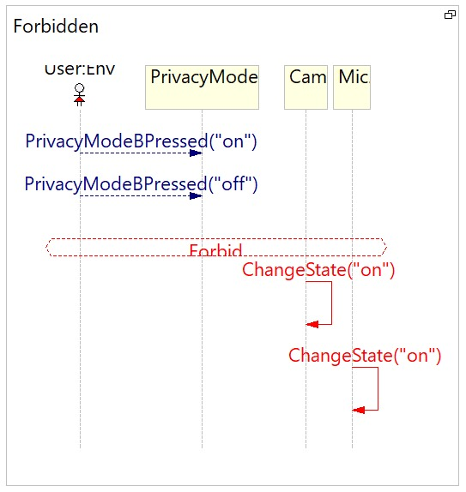
LSC Forbidden – When the user presses the PrivacyMode Button, the Camera and Microphone can’t change state to on until the user presses the PrivacyMode Button again.

Slide 29
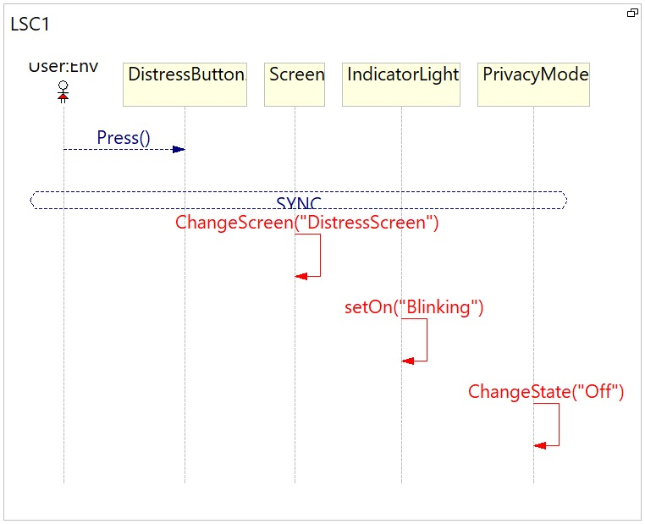
LSC1 – When the user presses the Distress Button, the Screen changes to Distress screen, the Indicatorlight turn on blinking and the Privacy mode turns off.

Slide 30
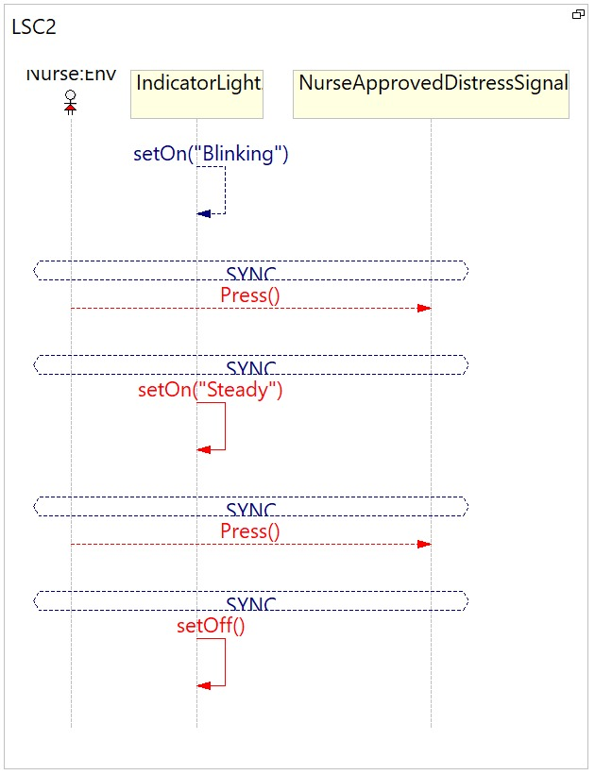
LSC2 – When the Indicatorlight is on blinking and the nurse presses the NurseApprovedDistressSignal button, the Indicatorlight changes to steady.
Then, when the nurse presses the NurseApprovedDistressSignal button, the Indicatorlight turns off

Slide 31
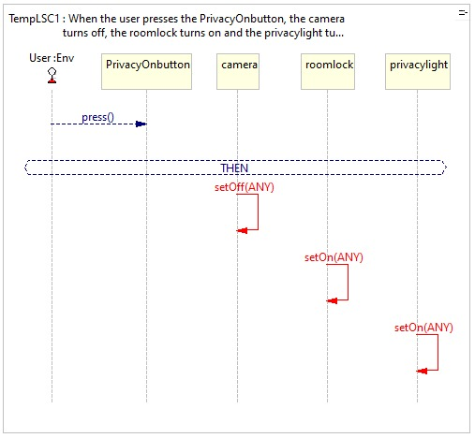
LSC3 – When the user presses the PrivacyOnbutton, the camera turns off,
the roomlock turns on and the privacylight turns on.

Slide 32
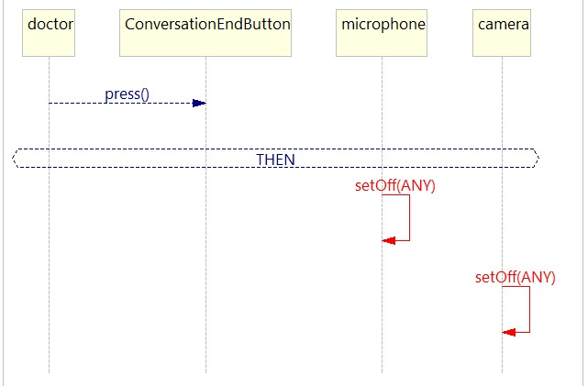
LSC4 – When the doctor presses the ConversationEndButton, the
microphone turns off and the camera turns off.

Slide 33
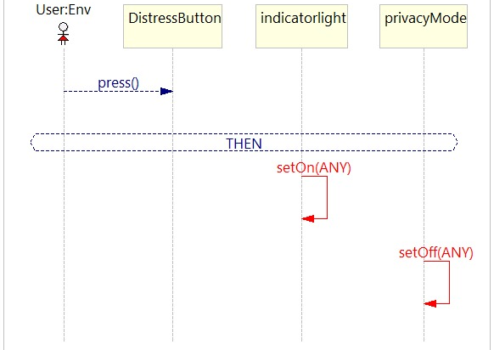
LSC5 – When the user presses the DistressButton, the indicatorlight
turns on and privacyMode turns off

Slide 34
Modeling Challenges:
Both LSC and Statecharts allowed us to model our system quite effectively, while dealing with each language challenges.
The main behavior we had trouble expressing in both languages was the privacy mode and how to create all it’s guards and limitations in an efficient way. We overcame this difficulty by creating privacy variable in statecharts, that is not available in LSC, and using forbidden (as seen in page 26) to define the privacy limitations.
Part of modeling that wasn’t expressed enough in statecharts were the components like thermometer, stethoscope and more that had only on-off states. These components were mentioned in the transitions as part of broadcasting but don’t show in the diagram in order to keep it simple and clear.
There are a lot of features that can be added to the system along the way, but we believe it is built in a modularly way so any addition will be quite easy to handle.

Slide 35
Reflection on course experience - Adi:
As a start I would like to note that we’ve done most of the work on this project together, while scheduling working times and updating each other our status.
My main parts in this project were modeling the primary system in PowerPoint in order to keep us coordinated. Afterwards I worked on the YAKINDU broadcasting, and when we finished the diagram I was in charge of creating the primary natural language sentences to help creating the LSC diagrams.
I really enjoyed this course, both in terms of content and in terms of flexibility. Especially in these Corona times while staying at home, I was able to manage my time according to my limitations and study when I’m free and concentrated. In addition, I felt more connected to this course then a lot others because of it’s content and I believe that any student should learn more how to model system demands into a visual language in order to work efficiently.
Of course I enjoyed working with Yuval who is my study partner for a long time, and there were no difficulties between us along the way, mostly because we are used to work together.

Slide 36
Reflection on course experience - Yuval:
My part in the project was building the first YAKINDU statechart that was the base for our project, after Adi planned the first system in PowerPoint. Afterwards we worked together on improving the system by adding features and components and dealing with a lot of errors. Along with it I made the LSC diagrams in playgo manually and used the natural language sentences to add more LSC diagrams.
I really liked taking this course online – I was able to watch the videos in my own time and make my progress in accordance to my abilities. Also I had a good time working with Adi as a group as we’re already used to do and I felt no difficulties while working as a team.
This course helped me understand the concepts of visual programing better and made me realize it’s a very useful tool and I might be using it in the future in one way or another.

Slide 37

Thank you!

